Slide 1
Modeling of a passenger ship evacuation
project and presentation by
Schmid Fabian, Brechbuehler Raphael, Reber Andreas, Eugster Manuela

Slide 2

Table of contents
Costa Serena
Fundamental questions
Model and Implementation
Results and Discussion
Outlook
Questions

Slide 3
Costa Serena

Slide 4
Fundamental Questions

Slide 5
Force Model

Slide 6
Implementation
clogging agents
general code adjustments

Slide 7
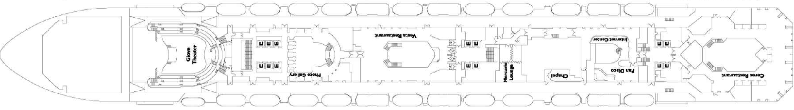
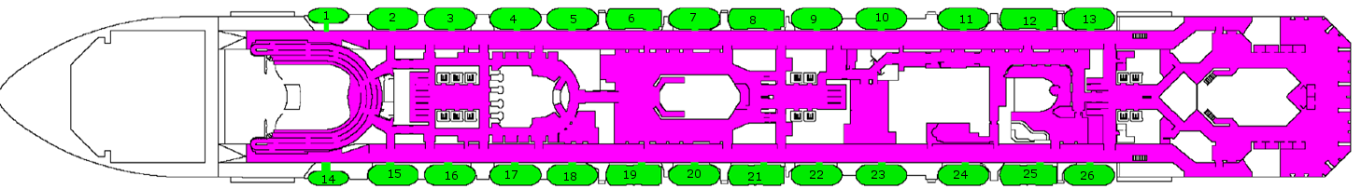
Costa Serena- Abstraction
Notes:
stairs, conversion similiarities and reduction

Slide 8
Results
Notes:
show one comparision→ added stairs/standard….

Slide 9
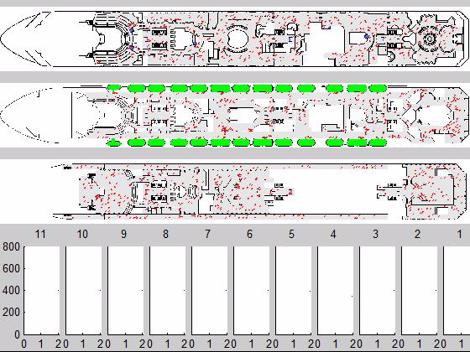
standard -ship deck simulation
Data:
floors: 11
exits: 26
capacity: 180
agents per floor: 400
timestep: 0.02 s
meter per pixel:
0.161
x
Number of agents on floor x
time

Slide 10
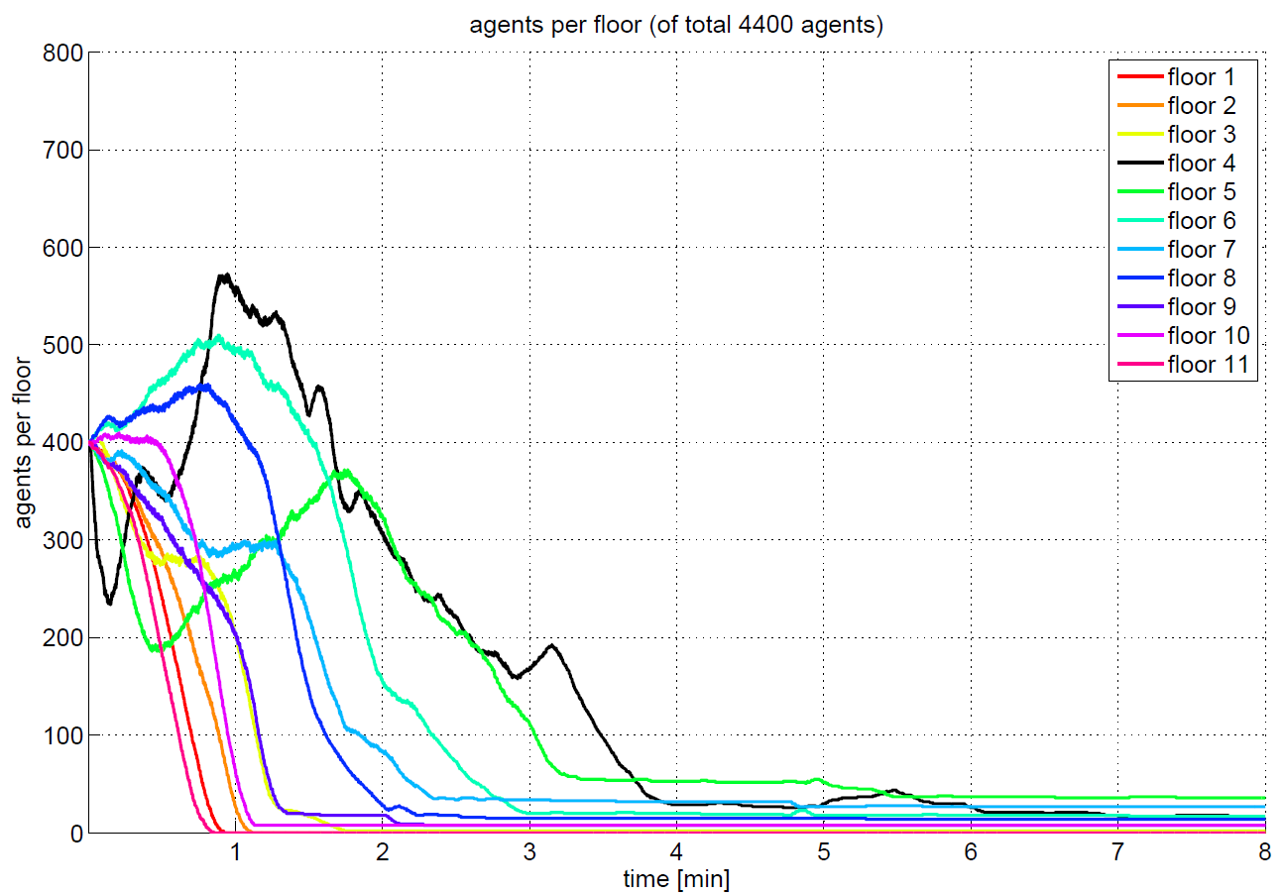
standard

Slide 11
Bottlenecks

Slide 12
Added stairs

Slide 13
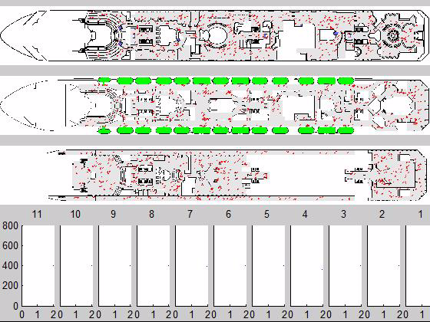
added stairs -ship deck simulation
Data:
floors: 11
exits: 26
capacity: 180
agents per floor: 400
timestep: 0.02 s
meter per pixel:
0.161
x
Number of agents on floor x
time

Slide 14
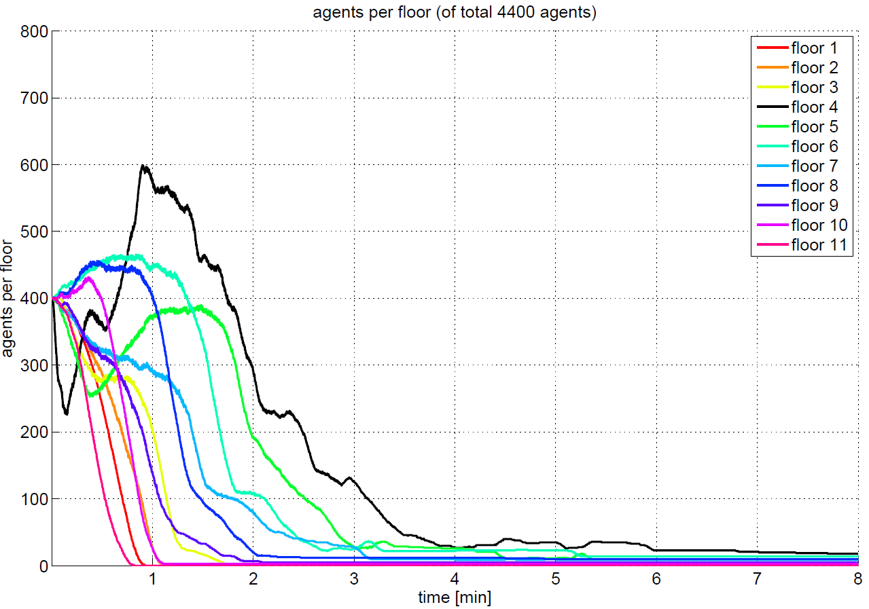
added stairs

Slide 15
Vary lifeboats

Slide 16
Crew command

Slide 17
Discussion

Slide 18
Outlook

Slide 19
Questions???

